Slide 1
Object Detection Using Faster R-CNN
Aashish Mahato

Slide 2
Agenda
Object Detection
R-CNN
Fast R-CNN
Faster R-CNN

Slide 3
Object Detection

Slide 4
What is Object Detection?
Object detection is a computer vision solution that identifies objects, and their locations, in an image.
An object detection system will return the coordinates of the objects in an image that it has been trained to recognize.
The system will also return a confidence level, which shows how confident the system is that a prediction is accurate.

Slide 5
Key Components of Object Detection
1. Image Classification
Image classification assigns a label to an entire image based on its content. While it's a crucial step in understanding visual data, it doesn't provide information about the object's location within the image.

Slide 6
Key Components of Object Detection
2. Object Localization
Object localization goes a step further by not only identifying the object but also determining its position within the image. This involves drawing bounding boxes around the objects.

Slide 7
Key Components of Object Detection
3. Object Detection
Object detection merges image classification and localization. It detects multiple objects in an image, assigns labels to them, and provides their locations through bounding boxes.

Slide 8
Region-Based Convolutional Neural Networks (R-CNN)

Slide 9
What is R-CNN?
Region-based Convolutional Neural Networks (R-CNN) are a family of machine learning models for computer vision, and specifically object detection and localization.
The original goal of R-CNN was to take an input image and produce a set of bounding boxes as output, where each bounding box contains an object and also the category (e.g. car or pedestrian) of the object.
In general, R-CNN architectures perform selective search over feature maps outputted by a CNN.

Slide 10
What is R-CNN?
The following covers some of the versions of R-CNN that have been developed.
November 2013: R-CNN
April 2015: Fast R-CNN
June 2015: Faster R-CNN
March 2017: Mask R-CNN
December 2017: Cascade R-CNN
June 2019: Mesh R-CNN

Slide 11
How R-CNN Works?
1. Region Proposal
R-CNN starts by dividing the input image into multiple regions or subregions. These regions are referred to as "region proposals" or "region candidates."
The region proposal step is responsible for generating a set of potential regions in the image that are likely to contain objects.
R-CNN does not generate these proposals itself; instead, it relies on external methods like Selective Search or EdgeBoxes to generate region proposals.

Slide 12
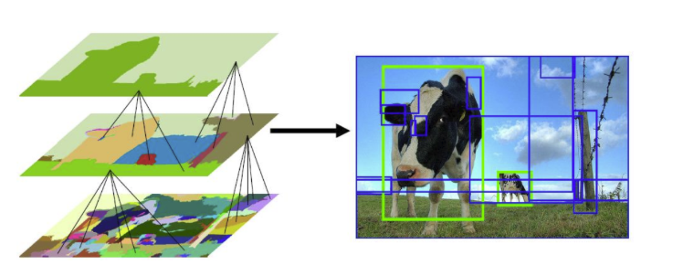
1. Region Proposal

Slide 13
How R-CNN Works?
2. Feature Extraction
Once the region proposals are generated, approximately 2,000 regions are extracted and warped to a consistent input size that the CNN expects (e.g., 224x224 pixels) and then it is passed through the CNN to extract features.
The CNN used is AlexNet and it is typically fine-tuned on a large dataset like ImageNet for generic feature representation. The output of the CNN is a high-dimensional feature vector representing the content of the region proposal.

Slide 14
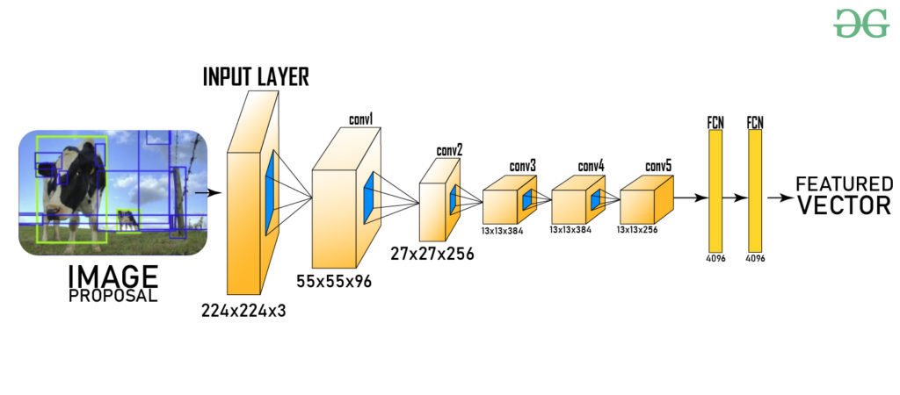
2. Feature Extraction

Slide 15
How R-CNN Works?
3. Object Classification
The extracted feature vectors from the region proposals are fed into a separate machine learning classifier for each object class of interest. R-CNN typically uses Support Vector Machines (SVMs) for classification. For each class, a unique SVM is trained to determine whether or not the region proposal contains an instance of that class.
During training, positive samples are regions that contain an instance of the class. Negative samples are regions that do not.

Slide 16
How R-CNN Works?
4. Bounding Box Regression
The initial boxes from Selective Search are often imprecise.
For the regions that the SVMs classified as an object, R-CNN uses a separate bounding box regressor.
This is a linear regression model (trained for each class) that learns to predict small corrections to the original box's coordinates (its center, width, and height) to make it fit the object more tightly.

Slide 17
How R-CNN Works?
5. Non-Maximum Suppression (NMS)
After classifying and regressing bounding boxes for each region proposal, R-CNN applies non-maximum suppression to eliminate duplicate or highly overlapping bounding boxes.
NMS ensures that only the most confident and non-overlapping bounding boxes are retained as final object detections.

Slide 18
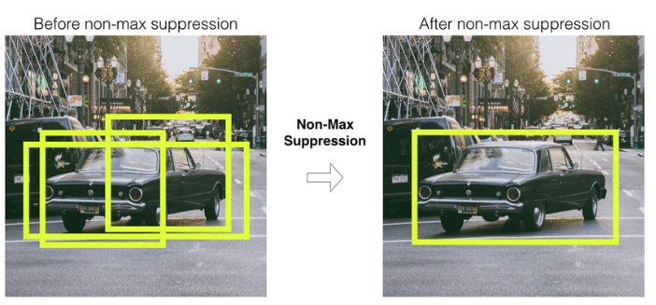
5. Non-Maximum Suppression (NMS)

Slide 19
Fast R-CNN

Slide 20
Fast R-CNN
Fast R-CNN optimizes the R-CNN architecture by sharing computations across proposals. Key improvements include:
Single Stage Processing: Instead of extracting features for each region proposal independently, Fast R-CNN processes the entire image once through the CNN to generate a feature map. The region proposals are then extracted from this shared feature map.
Softmax Classifier: Fast R-CNN replaces the SVM with a softmax classifier, allowing for end-to-end training of the network.

Slide 21
Fast R-CNN
Improved Bounding Box Regression: Fast R-CNN enhances the bounding box regression process, leading to better localization accuracy.

Slide 22
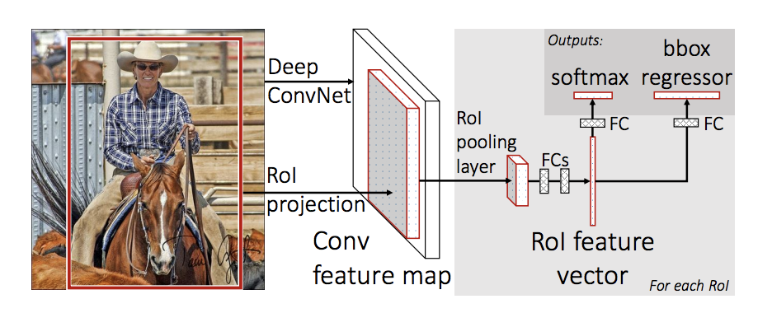
Fast R-CNN

Slide 23
Faster R-CNN

Slide 24
Faster R-CNN
Faster R-CNN further advances the R-CNN framework by incorporating a Region Proposal Network (RPN). Key features include:
Region Proposal Network: The RPN generates high-quality region proposals directly from the feature maps produced by the CNN, eliminating the need for selective search.
Shared Convolutional Features: Both the RPN and the detection network share the convolutional features, significantly reducing computation time.

Slide 25
Faster R-CNN
Improved Speed: Faster R-CNN achieves real-time processing speeds of around 0.1 seconds per image while maintaining high detection accuracy.

Slide 26
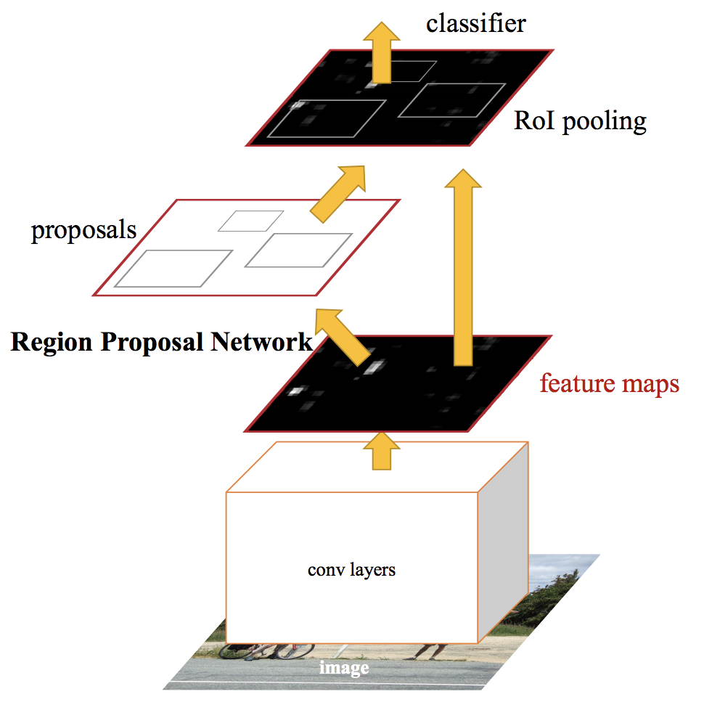
Faster R-CNN

Slide 27

Thank You

